Slide 1
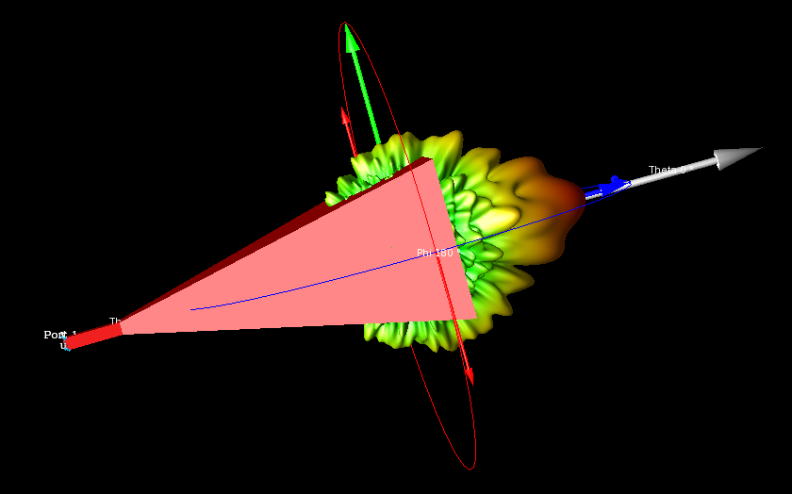
Horn Antenna( at X band) with Waveguide port
Based on Antenna Theory and Design by Stutzman & Thiele
Example 8.7: Design of an Optimum Gain Pyramidal Horn antenna, Page 413

Slide 2
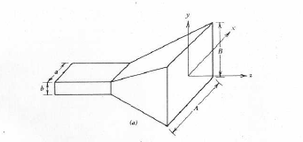
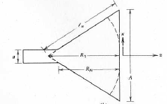
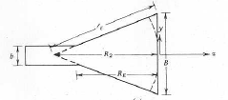
Geometry of Pyramidal Horn antenna
Overall Geometry
Cross section through
xz plane ( H Plane)
Cross section through
yz plane (E Plane)
Geometry specification of Horn antenna under design
A=18.46 cm, B= 14.55 cm, RE=RH=29.75 cm
Input section =WR 90
a=0.9 in= 2.286 cm
b=0.4 in = 1.016 cm

Slide 3
Design Steps
Drawing of Pyramidal Horn geometry
Setting up waveguide port
Setting up FEM boundary/Padding condition
Setting up Far Field sensor
Setting up FEM simulation
Result viewing

Slide 4
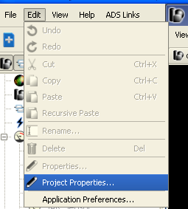
Step 1: Drawing of Pyramidal Horn geometry
a. Unit selection
The geometry will be drawn in unit=cm
Go to Edit> Project properties> Unit set = custom & Change length unit= cm
Press Done on project properties window
Save the project as
Pyramidal _Horn_X_band.ep

Slide 5
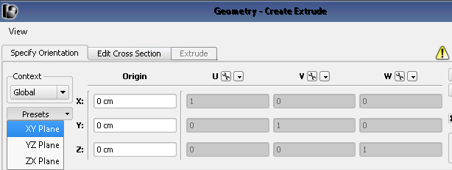
b. Drawing input waveguide section
Input section is of WR 90 waveguide with a=0.9 in= 2.286 cm & b=0.4 in = 1.016 cm
Go to Parts> Right Click> Create New >Extrude
On Geometry –Create Extrude window>Specify Orientation> On preset choose xy
plane and Orientation= (0,0,0) cm
On Geometry-Create Extrude window> Edit Cross section > Choose rectangle

Slide 6
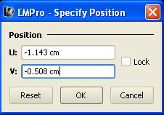
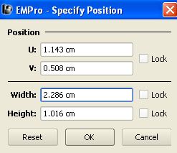
Right click on grid space and press Tab to enter the coordinates for waveguide. Enter coordinates as shown in following figure and press done
Again press Tab to enter coordinates for other side of Waveguide
Go to extrude and enter Extrude Distance = 5 cm

Slide 7
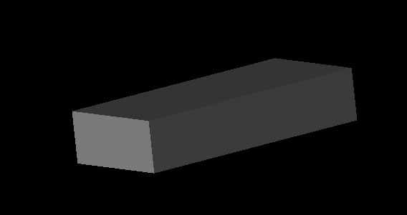
Go Back to Edit Cross section window and enter name of the model as WR90_In_Section and Press Done
This will create Input waveguide section of WR 90
Note : At this stage the Waveguide is solid block not hollow. We will make it hollow in upcoming slides.
Save project

Slide 8
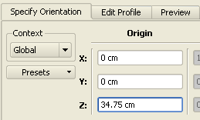
C. Drawing Horn Aperture
Dimension of Horn aperture A=18.46 cm, B= 14.55 cm
Go to Parts> Right Click> Create New >Extrude
On Geometry –Create Extrude window>Specify Orientation> On preset choose xy
plane and Orientation= (0,0, 34.75) cm
Note: Horn aperture is located at distance of Z=34.75 cm(= RE+ Length of Input Waveguide section)
On Geometry-Create Extrude window> Edit Cross section > Choose rectangle

Slide 9
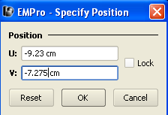
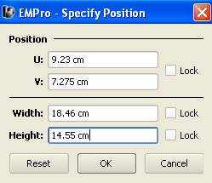
Right click on grid space and press Tab to enter the coordinates for rectangle as shown and press ok
Again press Tab to enter coordinates for other side of Rectangle
Name the rectangle as Aperture and press Done
Save project

Slide 10
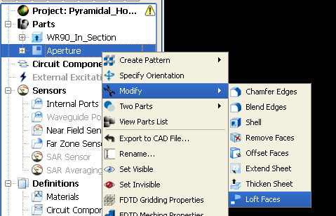
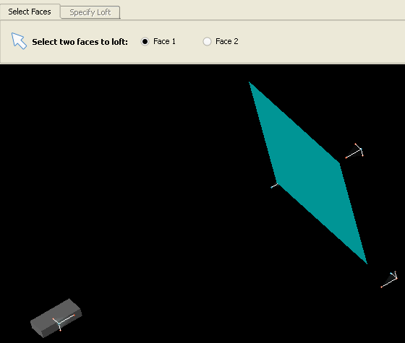
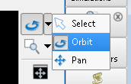
D. Creating Pyramidal horn geometry
We will use loft operation to join Horn Aperture with Waveguide input section
Go to Parts> Aperture>Right Click> Modify> Loft Faces
On Geometry Loft Faces window> Select faces, choose Face 1 as face of aperture facing towards Waveguide section
Note: to rotate the geometry you can use Orbit function located on right side
Of EMPro GUI:

Slide 11
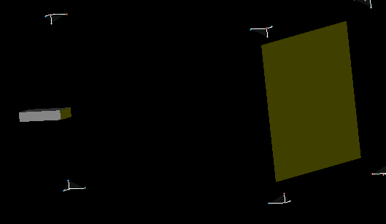
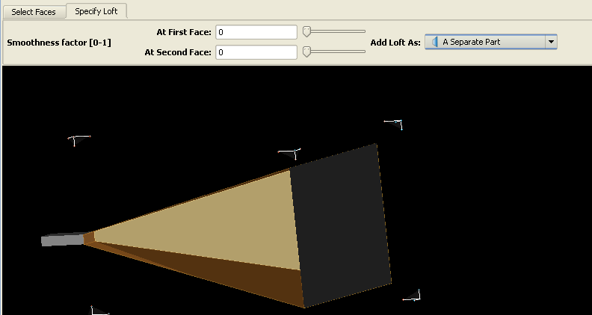
Rotate the geometry to select Waveguide face facing Aperture
Specify Loft as shown and press done

Slide 12
The new object is added as Aperture in Part list
Rename it as Horn by right click Aperture
Go to Boolean> Existing parts> Select Blank(s): Select Horn
Go to Boolean> Existing parts > Select Tool(s): Select WR90_In_Section
Select Operation>Union and press Done
This will Unite Waveguide Input section with Horn.
Go to Horn object in part list> Right Click> Modify> Shell
Select Open face: Choose Horn aperture and Input of Waveguide

Slide 13
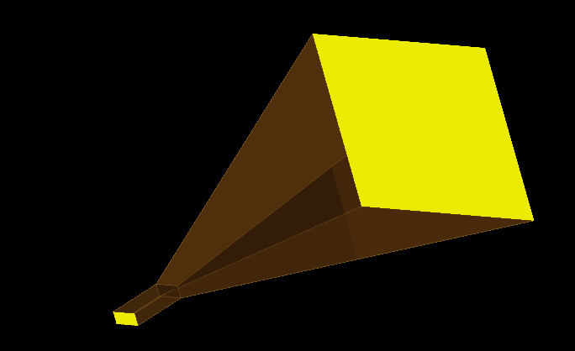
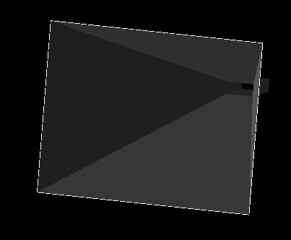
Select Open face: Choose Horn aperture and Input of Waveguide
Note: to choose two faces simultaneously use ctrl key
Specify Thickness =0.05 cm and press done
Select Aperture sheet object in part list> Right click> make it invisible
The pyramidal horn geometry is created
Save project

Slide 14
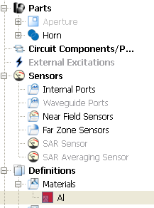
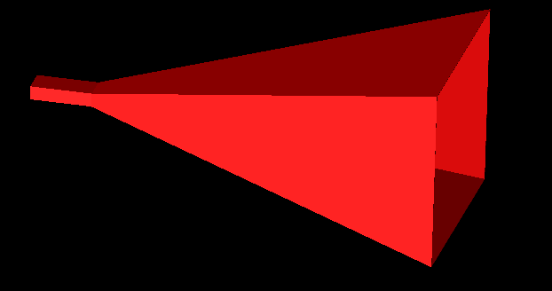
E. Assign Material to Horn
Go to Definitions> Materials > Select from default Material Library
Choose Aluminum –Al from the list
Assign this to Horn Object
Save project

Slide 15
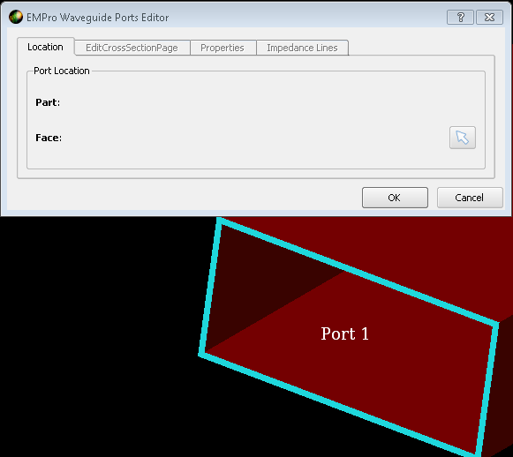
Step 2: Setting up waveguide port
To define Waveguide port Switch On only FEM simulation
Go to Circuit Components /Ports> New waveguide Port. This will open waveguide port definition GUI
Select the location of the port by clicking the edge of the waveguide

Slide 16
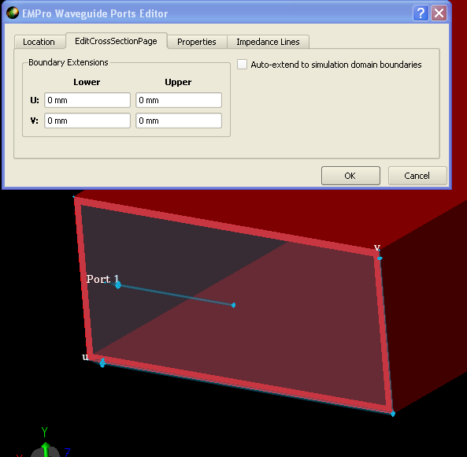
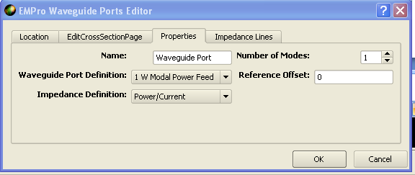
Once location is defined Go to Edit Cross section Page > Uncheck Auto extend to simulation domain boundaries( It will extend port up to waveguide section)
Go to properties Tab and choose Waveguide Port definition = 1 W Modal Power Feed and Impedance Definition= Power/current

Slide 17
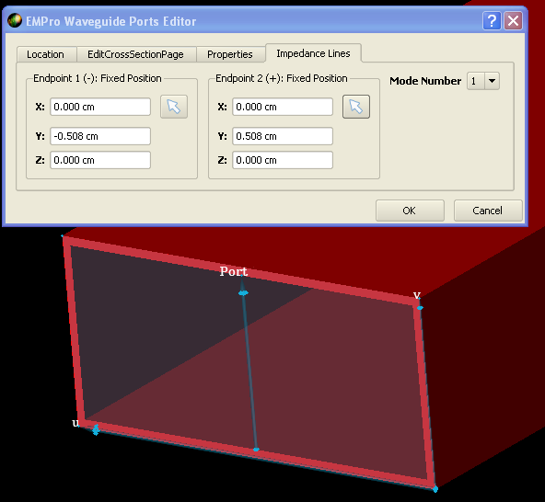
Go to Impedance line,
Endpoint 1 is located at the inside bottom edge of the waveguide
Endpoint 2 is located at the inside top edge of the waveguide
Mode number=1 ( as the antenna is going to operate in dominant mode TE10)
Press OK, this will define waveguide port
Note: Waveguide port will appear as invalid. This will become valid once we define boundary condition
Save project

Slide 18
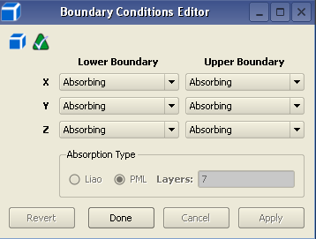
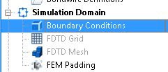
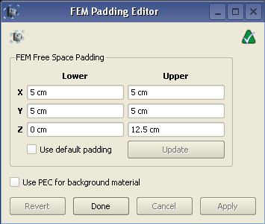
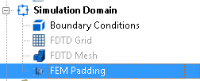
Step 3: Setting up FEM boundary/Padding condition
Go to Simulation Domain > Boundary Condition and choose Absorbing Boundary condition
in all directions and press Done
Go to Simulation Domain> FEM Padding > define padding as shown and press Done
Note : Lower Z=0 cm will make wave guide port valid. This is required so that Waveguide port end on boundary
Save project

Slide 19
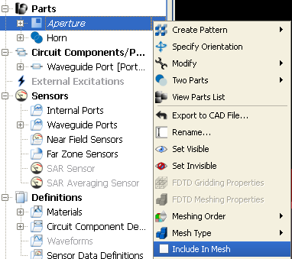
Step 5: Setting up FEM Simulation
Go to the Parts> Aperture > Right Click > Uncheck Include in Mesh. This will take Aperture
out of simulation domain
Note: After this step the project will be valid. The project was appearing invalid earlier as no material was assigned to Aperture, which is not required once Aperture is taken out of simulation domain
Click on Simulation right side of GUI, this will open Simulation window
Select New FEM simulation

Slide 20
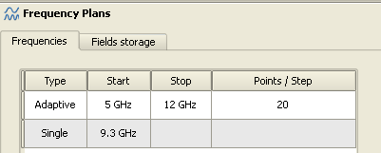
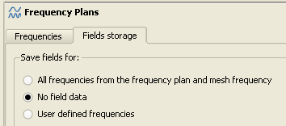
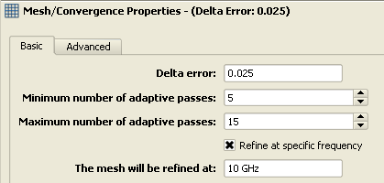
In FEM simulation window enter Frequency Plan > Frequencies as shown
In FEM simulation window enter Frequency Plan > Fields Storage as shown
Go to Mesh/Convergence Properties> Basic, enter delta error=0.01 and Minimum number of adaptive passes =5 and Maximum number of adaptive passes =15

Slide 21
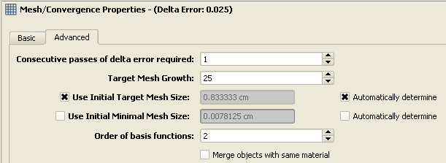
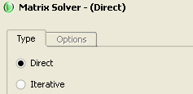
Go to Mesh/Convergence Properties> Advanced , Consecutive passes of delta error=1. Target mesh growth=25. Use Initial target mesh size and check automatically determine.
Use direct matrix solver
Click Create and run simulation at bottom of the FEM simulation GUI
Save project

Slide 22
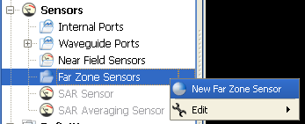
Step 4: Setting up Far field sensor
Go to Sensor> Far zone sensor
Define first 3 D far zone sensor with increment 1 deg
In properties tab name is 3D FF and press Done
Similarly choose another Far field sensor for phi =0 deg with increment 1 deg and name it 2D
FF = Phi 0 deg
Similarly define another sensor for Phi=90 deg
Go to Simulation Domain> FEM Padding > define padding as shown and press Done
Note : Lower Z=0 cm will make wave guide port valid. This is required so that Waveguide port end on boundary
Save project

Slide 23
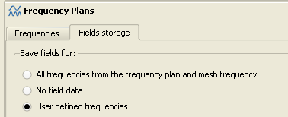
Go to Simulation > Create a new FEM simulation
Chose Simulation id=000001 under simulation result to reuse. This will load the all simulation setting of Simulation id=000001
Go to Frequency plan>Field Storage. Chose User defined frequencies. After this project will be Valid
Click Create and run simulation at bottom of the FEM simulation GUI

Slide 24
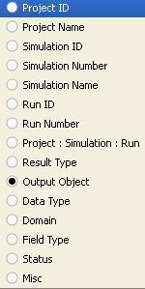
Step 6: Viewing Results
A. Port Results
Double click results Tab at the right side of GUI
This will open result window
Right Click

Slide 25
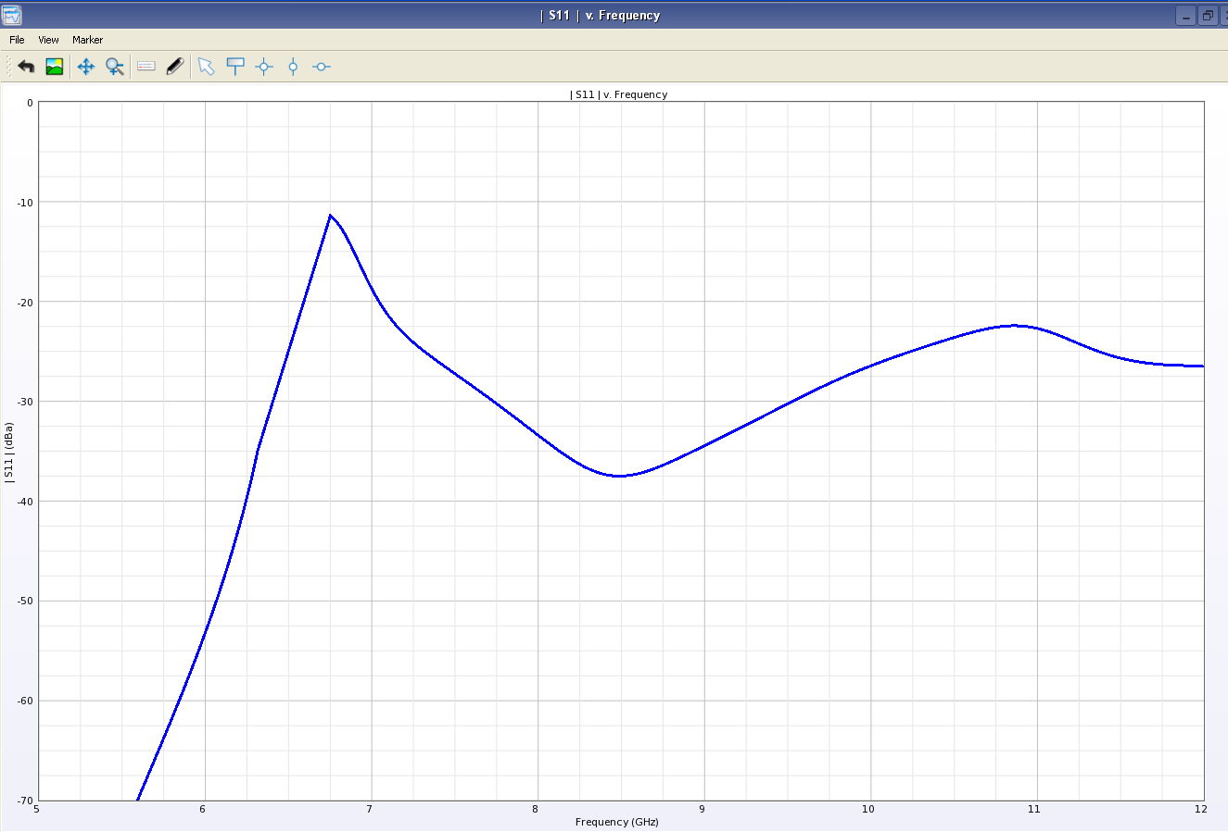
S Parameter
Choosing S parameter from Result type will list two plots: Discreet and Frequency
Frequency: Results in Plot

Slide 26
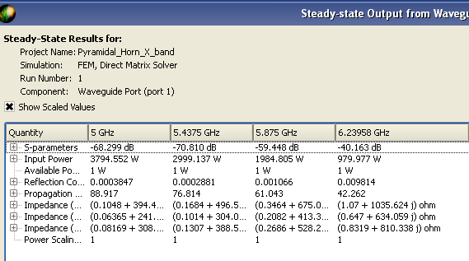
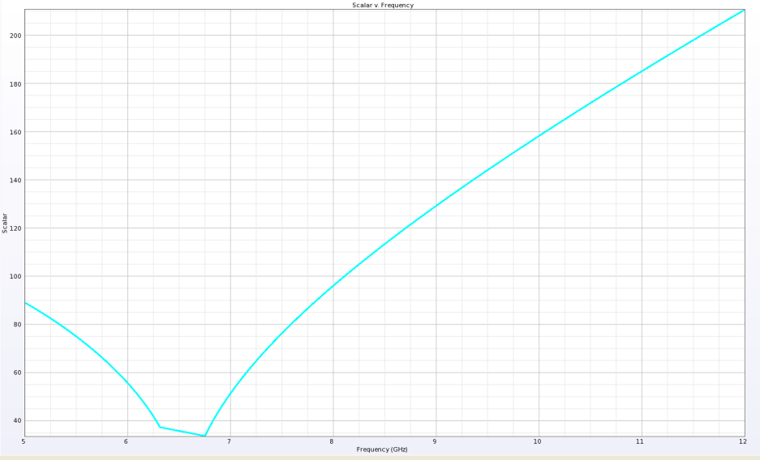
Propagation Constant
Choosing Propagation Constant from Result type will list two plots again: Discreet and Frequency
WR 90 Cutoff
Discreet: Results in Tabular form
For different frequencies
Frequency: Results in Plot

Slide 27
B. Radiation results- 3D plot
From Result window Choose 3D FF ( 3D Far field sensor defined earlier) and click E field under result type
This will load E Field Post processing GUI at the bottom
After Choosing frequency of interest click Apply, this will load 3D plot in GUI for desired frequency
Click to choose frequency

Slide 28
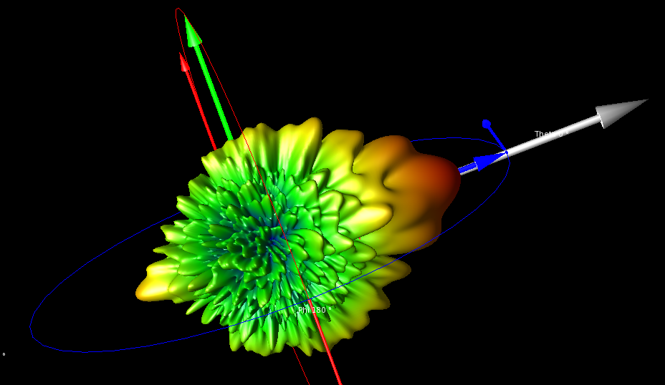
E plot at 9.3 GHz
Size and location control
Location of the plot control
Size control

Slide 29
Similarly from result window click to load Gain plots
Gain values can be seen from Statistics after choosing the desired frequency

Slide 30
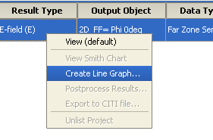
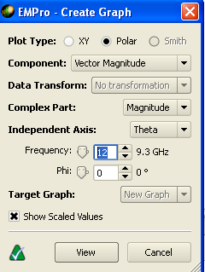
C. Radiation results- 2D plot
Choose 2D Plot under Object type and Gain Under Result type
Chose Create line Graph
This will open Create graph GUI. Chose Polar plot and frequency of interest( say 9.3 GHz) click View

Slide 31
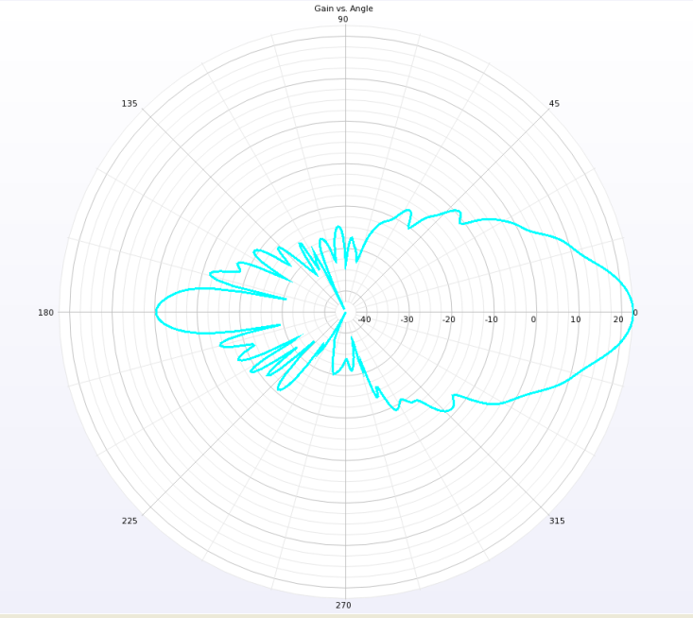
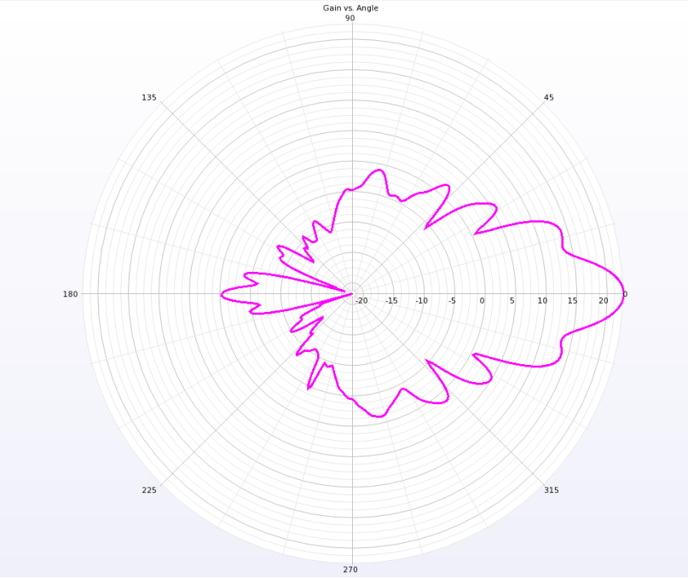
2D polar Gain plot in phi=0 deg plane for 9.3 GHz is loaded
Similarly Plot for Phi =90 deg can be seen if 2D FF= Phi 90 deg is chosen

